Slide 1


Shaping AI Strategies to Align with Business Objectives
This presentation outlines how leaders can guide AI initiatives to achieve desired business outcomes. It explores the importance of understanding AI capabilities, setting clear goals, and fostering a culture of innovation and experimentation. We'll also delve into crucial considerations like ethical implications and collaboration across departments.
by Jayesh Sharmila

Slide 2
Understanding the Importance of AI in Business Transformation
Enhanced Efficiency
Data-Driven Insights
Personalized Customer Experiences
Innovation and New Business Models
AI can automate routine tasks, freeing up human resources for more strategic work. From data analysis to customer service, AI can optimize processes and improve productivity.
AI algorithms can uncover hidden patterns and trends in data, providing valuable insights for better decision-making and competitive advantage.
AI can personalize customer interactions, offering tailored recommendations and services, leading to increased satisfaction and loyalty.
AI fuels innovation, enabling businesses to develop new products, services, and business models that leverage the power of advanced technologies.

Slide 3

Assessing Current AI Capabilities and Identifying Gaps
1
Data Infrastructure
2
Technical Expertise
Assess the quality and accessibility of data, ensuring sufficient resources for AI model training and development.
Evaluate the availability of skilled AI engineers and data scientists, or explore partnerships with AI experts.
3
AI Tools and Technologies
Identify the appropriate AI tools and platforms for your specific business needs and goals. Choose solutions that align with your current infrastructure and resources.

Slide 4



Defining Clear AI-Driven Business Objectives
Strategic Goals
1
Align AI objectives with overarching business goals like revenue growth, cost reduction, or improved customer satisfaction.
Specific AI Applications
2
Define specific AI projects like chatbot development, predictive analytics, or automation of marketing tasks.
Measurable Key Performance Indicators (KPIs)
3
Set clear metrics to track the success of AI initiatives, like conversion rates, customer satisfaction scores, or efficiency gains.

Slide 5
Aligning AI Initiatives with Overall Business Strategy
Strategic Planning
1
Develop a roadmap that outlines the implementation of AI initiatives in alignment with the company's long-term vision.
Resource Allocation
2
Allocate sufficient budget and human capital to support AI projects, ensuring a sustainable and successful implementation.
Communication and Stakeholder Engagement
3
Communicate AI initiatives to stakeholders, ensuring transparency and buy-in from all departments.

Slide 6




Fostering a Culture of Innovation and Experimentation
Encourage Experimentation
Cross-Functional Collaboration
Create an environment where employees feel comfortable exploring new AI solutions and taking calculated risks.
Foster a collaborative approach, bringing together experts from different departments to maximize AI potential.
Data-Driven Decision-Making
Promote a culture of data-driven insights, using AI to inform decisions and improve efficiency.

Slide 7

Addressing Ethical Considerations in AI Implementation
Bias and Fairness
1
Ensure AI models are developed and deployed in a fair and unbiased manner, minimizing potential risks of discrimination.
2
Privacy and Data Security
Implement robust data security measures to protect sensitive information and comply with privacy regulations.
Transparency and Explainability
3
Develop AI models that are transparent and explainable, allowing users to understand how decisions are made.

Slide 8
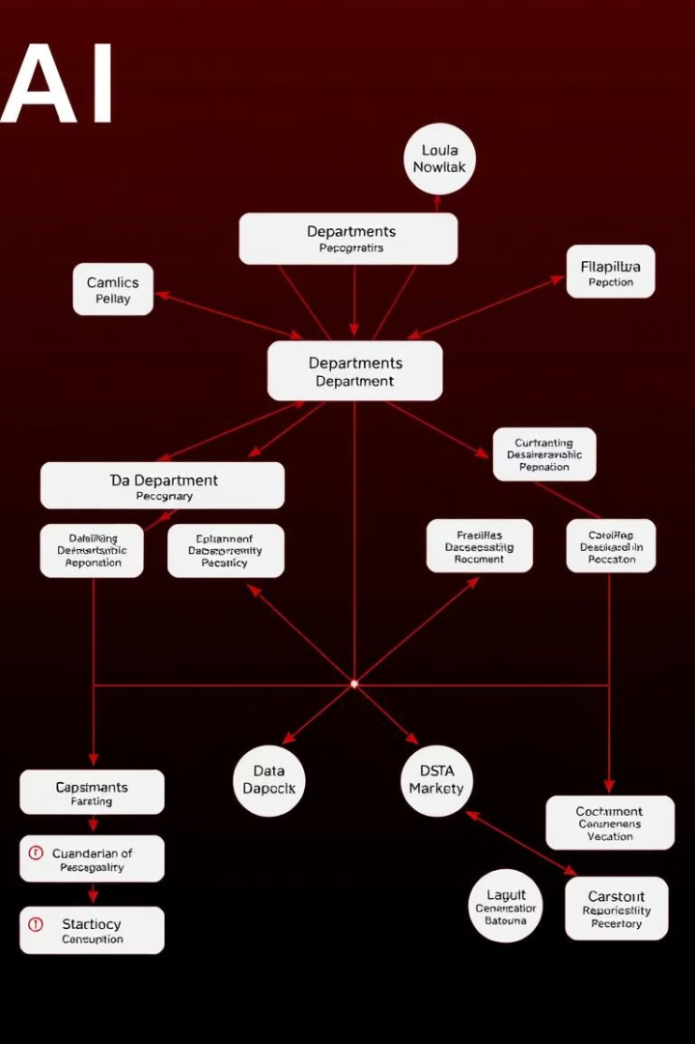
Empowering Cross-Functional Collaboration for AI Success
Data Science and Engineering
Business and IT
Align business objectives with IT capabilities, ensuring seamless integration of AI solutions into existing systems.
Collaboration between data scientists and engineers is crucial for developing, deploying, and maintaining AI models.
Operations and Marketing
Collaboration across departments ensures AI initiatives align with operational needs and marketing strategies.

Slide 9

Measuring and Monitoring the Impact of AI Initiatives
1
2
Track Progress
Identify Areas for Improvement
Monitor the performance of AI initiatives against defined KPIs, assessing the impact on key business objectives.
Analyze data to identify areas where AI can be further optimized or new initiatives can be implemented.
3
Adjust Strategies
Be adaptable and adjust strategies based on data-driven insights and feedback, ensuring continuous improvement.

Slide 10

Conclusion and Key Takeaways
By embracing a holistic approach to AI strategy, organizations can leverage the power of AI to achieve their business objectives. By fostering a culture of innovation, collaboration, and ethical implementation, leaders can navigate the evolving landscape of AI and drive success.

